Slide 1
Azure Containers

Slide 2
Agenda
Introduction to Containers
What are containers?
Containers and VMs
Advantages
Introduction to Docker
Docker Engine
Docker Architecture
Docker Installation
Docker commands
Docker Images
Docker for Azure
Creating and running a Docker App

Slide 3
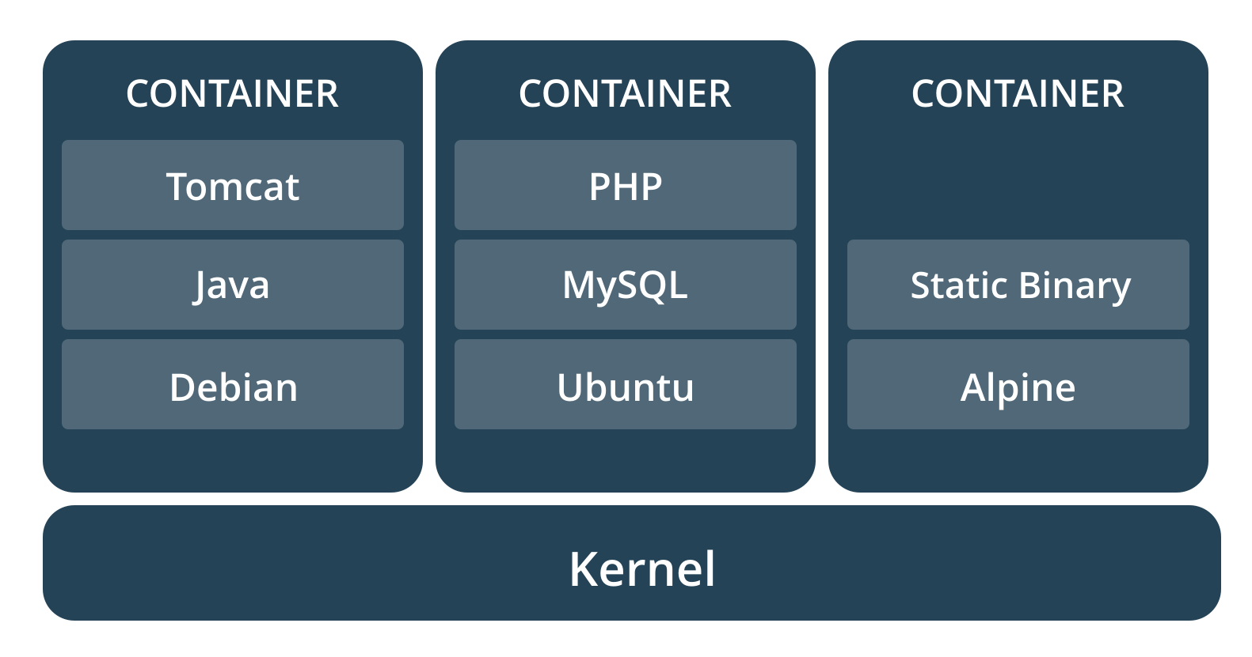
What are containers?
A standardized unit of software

Slide 4
Containers
A container image is a lightweight, stand-alone, executable package of a piece of software that includes everything needed to run it: code, runtime, system tools, system libraries, settings.
Available for both Linux & Windows-based apps
Containers isolate software from its surroundings, for example differences between development and staging environments and help reduce conflicts between teams running different software on the same infrastructure.
Container becomes the unit for distributing and testing your application.

Slide 5
Containers vs. VMs
Containers
Containers are an abstraction at the app layer that packages code and dependencies together.
Virtual Machines
Virtual machines (VMs) are an abstraction of physical hardware turning one server into many servers.
Multiple containers can run on the same machine and share the OS kernel with other containers, each running as isolated processes in user space.
Containers take up less space than VMs (container images are typically tens of MBs in size), and start almost instantly
The hypervisor allows multiple VMs to run on a single machine. Each VM includes a full copy of an operating system, one or more apps, necessary binaries and libraries - taking up tens of GBs.
VMs can also be slow to boot.

Slide 6
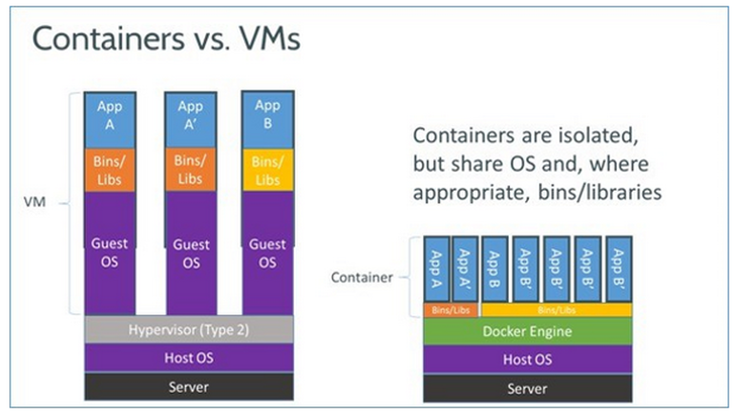
Containers vs. VMs

Slide 7
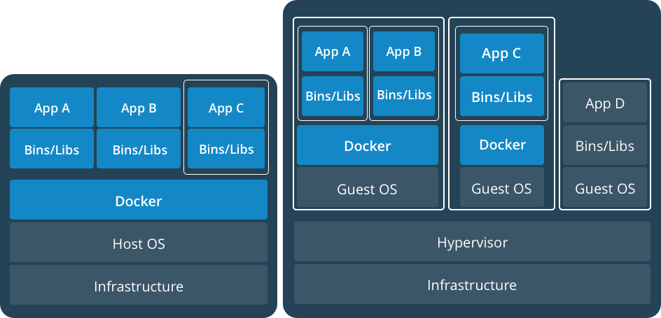
Containers and VMs together

Slide 8
Advantages
More applications can run on the same hardware than other technologies
Easy for developers to quickly create ready-to-run containerized apps
Makes managing and deploying applications much easier
Responsive deployment and scaling

Slide 9
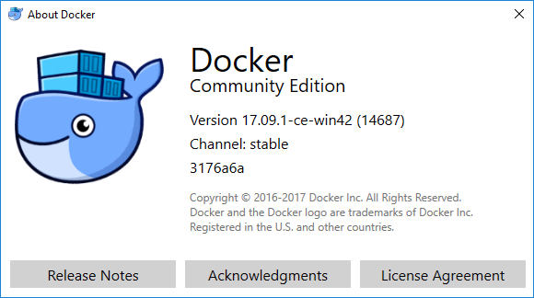
Docker
Docker is a an open platform that provides the tooling and environment to package and run an application in a container.

Slide 10
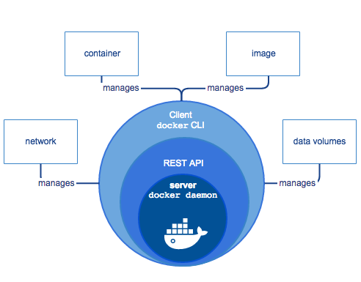
Docker Engine
A Docker Engine is a client-server application with these components:
A server which is a type of long-running program called a daemon process
A REST API which specifies interfaces that programs can use to talk to the daemon and instruct what to do
A command line interface (CLI) client

Slide 11
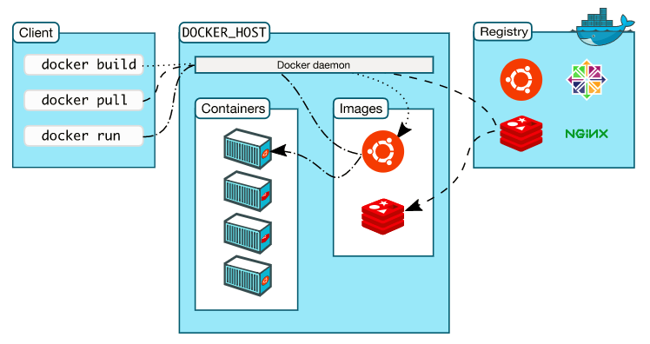
Docker Architecture

Slide 12
Installation
Docker is available in two editions: Community Edition (CE) and Enterprise Edition (EE).
Docker Community Edition (CE) is ideal for developers and small teams looking to get started with Docker and experimenting with container-based apps. Docker CE has two update channels, stable and edge:
Stable gives you reliable updates every quarter
Edge gives you new features every month
Docker CE for Windows is a native Windows Desktop application to easily setup a Docker development environment on a Windows PC
Download link (stable): https://download.docker.com/win/stable/Docker%20for%20Windows%20Installer.exe

Slide 13
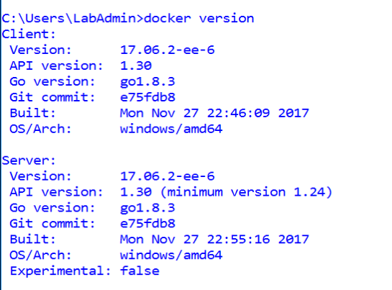
Docker commands

Slide 14
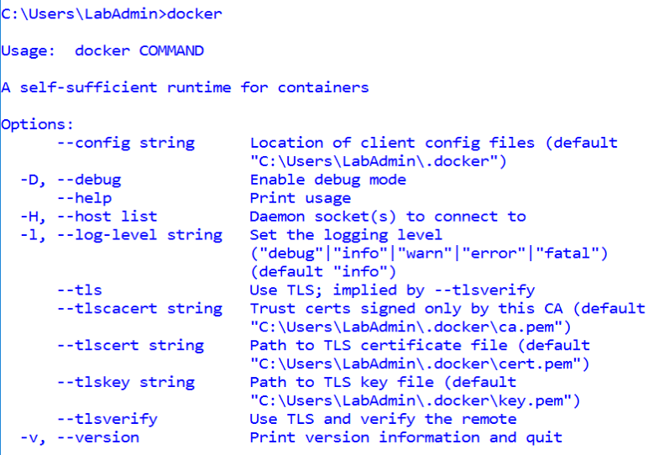

Slide 15
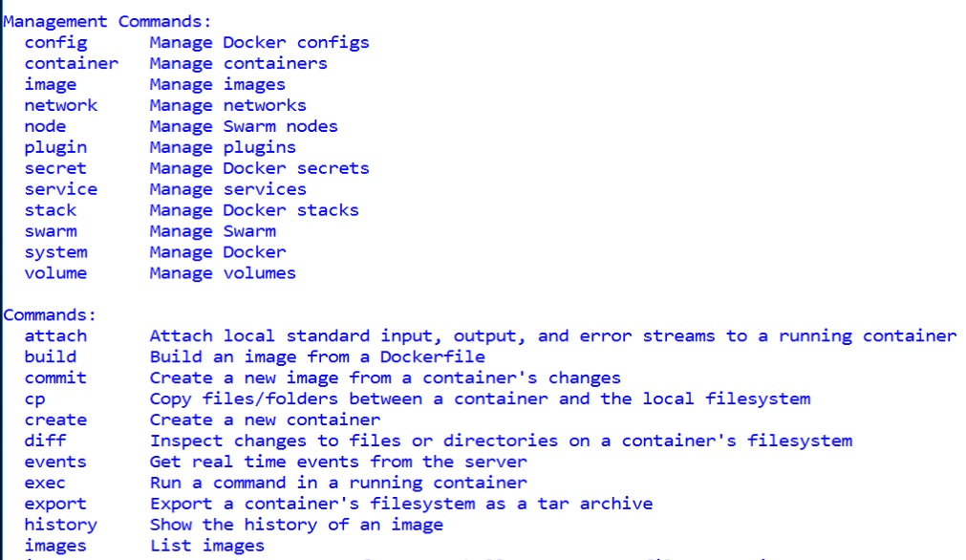

Slide 16
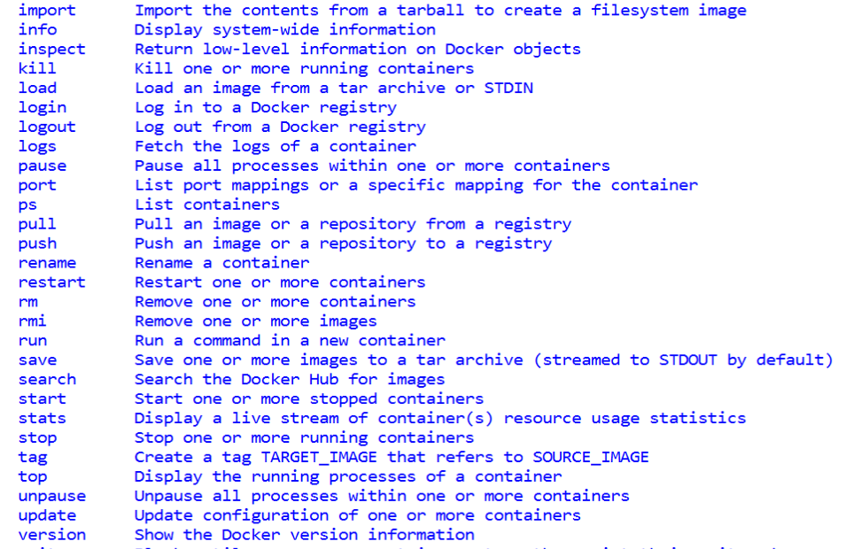

Slide 17
Nano Server and Windows Server Core
Nano Server
Server OS optimized for private clouds and datacenters
Significantly smaller in size compared to Windows Server Core
Base OS image is ~ 380MB
Ideal for “Green field” development
Host for applications that run in container (IIS, ASP.NET Core, etc.)
Only supports 64-bit applications
Windows Server Core
Provides range of features not available in Nano Server
Size is significantly larger compared to Nano Server
Base OS image is ~ 5 GB
Supports both “Green field” and “Brown field” development
Host for applications that run in container (IIS, ASP.NET 4.x, ASP.NET Core, etc.)
Supports both 32-bit and 64-bit applications

Slide 18
Docker commands
Few docker commands
docker version
docker run –it microsoft/nanoserver “powershell.exe”
Hostname
Displays container ID
Use another PowerShell instance to display difference between local server and container
Get-Process - Shows PowerShell as a process in container environment
exit - Exits the shell
docker images
docker ps
docker ps –a
Docker run –d Microsoft/nanoserver ping –t localhost
Docker stop xxx (first unique chars)

Slide 19
Running a web application in Docker - Demo
Create project folder in Host machine for storing image artifacts
Copy this into a Dockerfile
FROM microsoft/windowsservercore
RUN powershell –Command Add-WindowsFeature Web-Server
COPY index.htm /inetpub/wwwroot
EXPOSE 80
CMD [“ping localhost -t”]
Create index.htm file in the project folder with some content
Navigate out of the folder and excute:
Docker build –t <projectname> . (dot)

Slide 20
Running a web application in Docker – Demo 2
Create project folder in Host machine for storing image artifacts
Copy this into a Dockerfile
FROM microsoft/nanoserver
RUN powershell –Command Add-WindowsFeature Web-Server
COPY index.htm /inetpub/wwwroot
EXPOSE 80
CMD [“ping localhost -t”]
Create index.htm file in the project folder with some content
Navigate out of the folder and excute:
Docker build –t <projectname> . (dot)

Slide 21
Running a web application in Docker – Demo 3
In Visual Studio, create ASP.NET Core 1.1 Web API project
Copy this into a Dockerfile
FROM microsoft/aspnetcore:1.1
ARG source
WORKDIR /app
COPY ${source:-obj/Docker/publish}
ENTRYPOINT[“dotnet”, “FirstDockerAPI.dll”]
Build

Slide 22
Demo

Slide 23
Docker for Azure
Features:
Native to Docker
Skip the boilerplate and maintenance work
Minimal, Docker-focused base
Self-cleaning and self-healing
Logging native to the platforms
Next-generation Docker bug reporting tools

Slide 24
Setup & pre-requisites
Pre-requisites:
Azure Subscription with Administrator privileges
SSH key to use when accessing Docker installed on Azure
Configuration:
Docker for Azure is installed with Azure template that configures Docker in swarm mode, running on VMs backed by custom VHD
Deploy on Azure using Portal or CLI
Configuration options:
Manager Count
Manager VM size
Worker VM size
Worker count

Slide 25
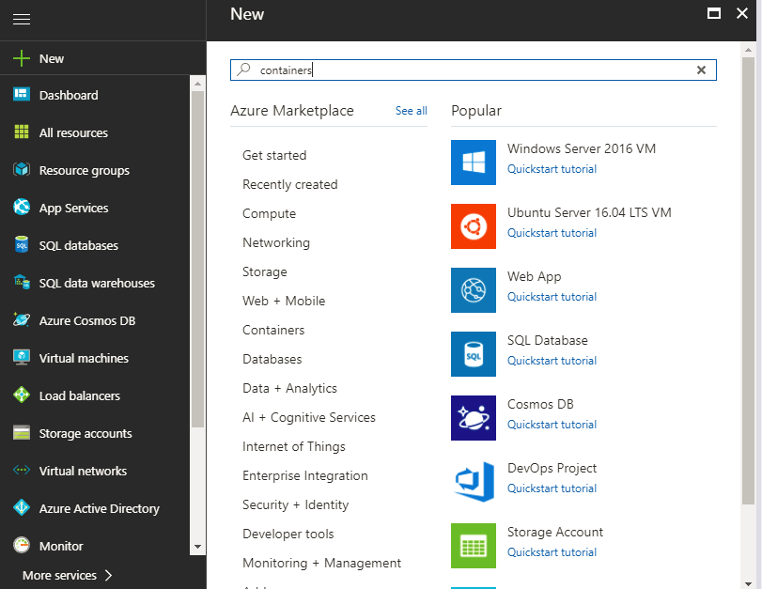
Demo

Slide 26
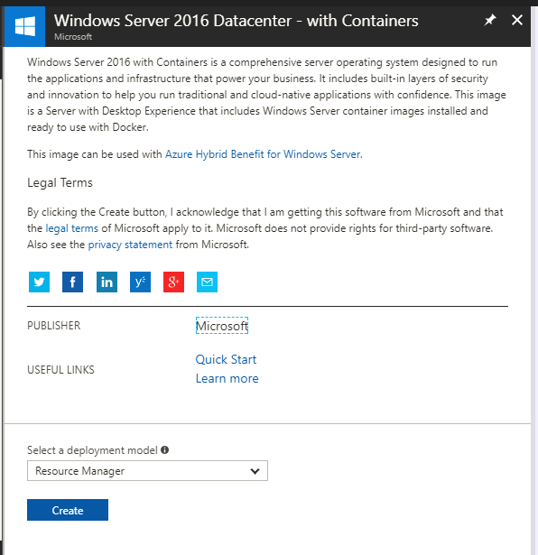

Slide 27
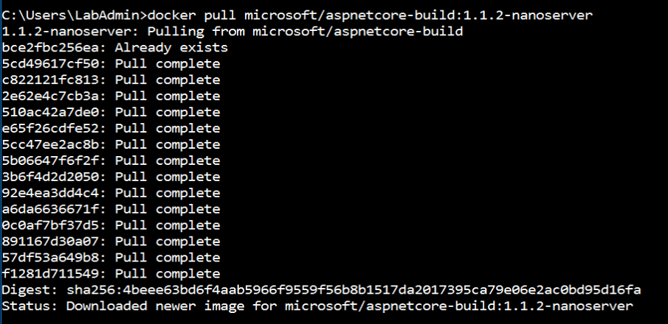
Demo commands
docker pull microsoft/aspnetcore-build:1.1.2-nanoserver

Slide 28
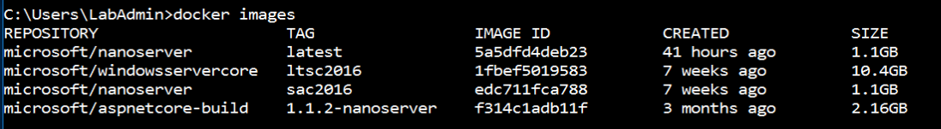
Docker commands
docker images
docker run –it -–name firstapp f31
In another CMD window, type to check if the docker image is running:
docker ps

Slide 29
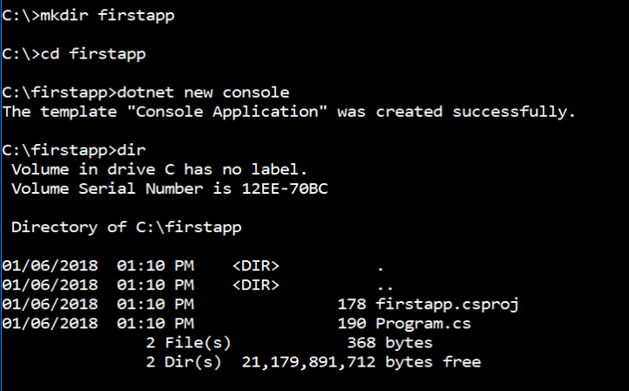
Creating first docker app
mkdir firstapp
cd firstapp
dotnet new console
type program.cs

Slide 30
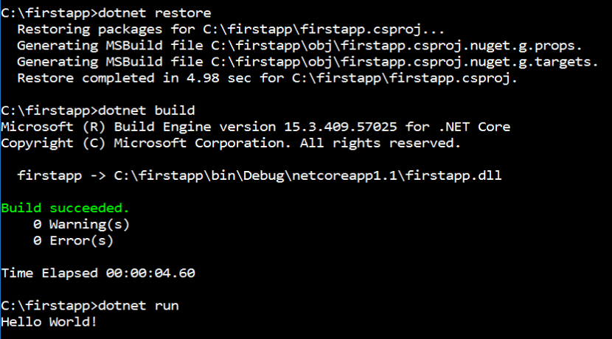
Run first docker app
dotnet restore
dotnet build
dotnet run
Optional:
echo dotnet run –p c:\firstapp\firstapp.csproj > hello.cmd
hello.cmd

Slide 31
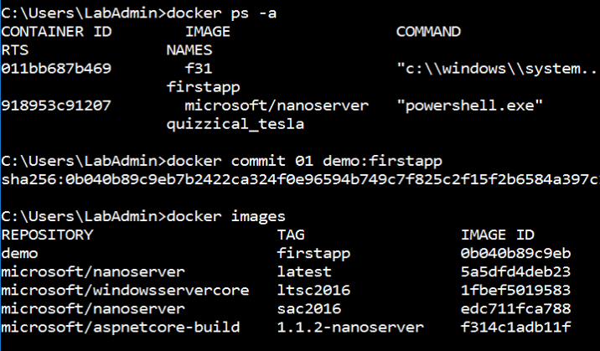
Creating an image
docker commit xx demo:firstapp
docker images

Slide 32
Demo-5

Slide 33
Thank you
Technical Learning Services

